Slide 2
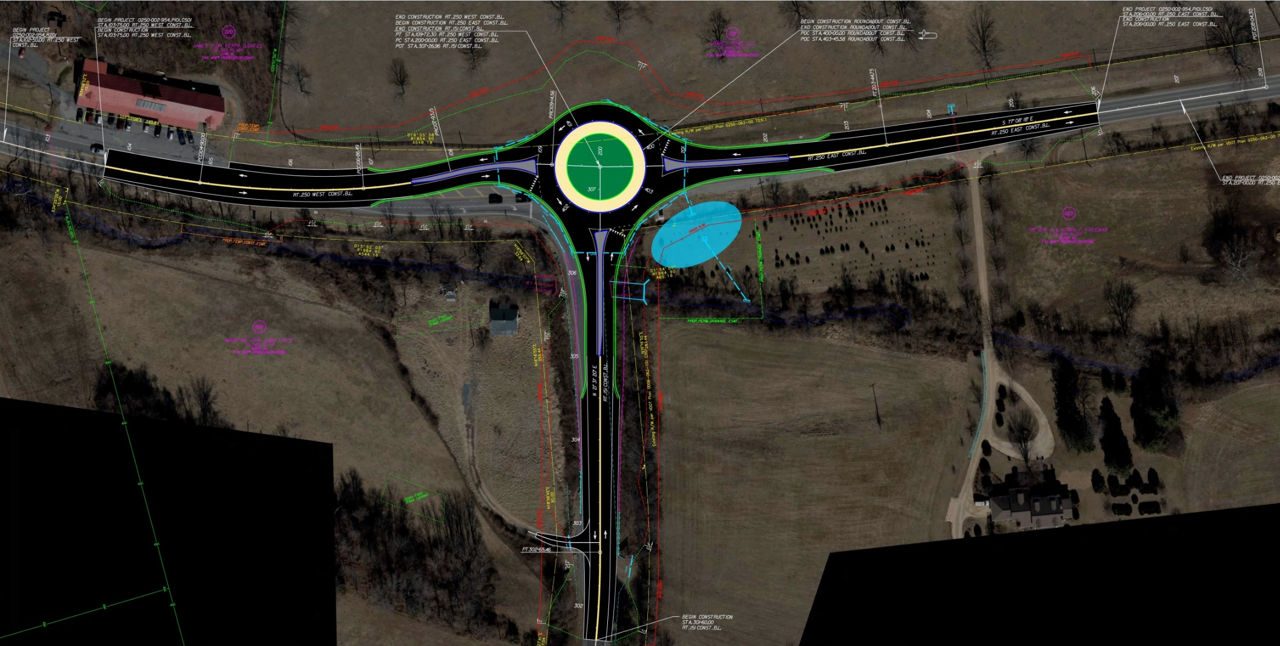
Crozet Community Advisory Committee
Joel DeNunzio
VDOT Charlottesville
March 13, 2019
Notes:
Overview of todays presentation

Slide 3
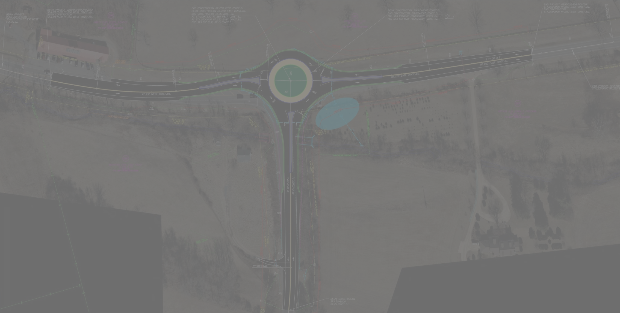
Crozet Community Advisory Committee
Projects
  Route 240 Bridge at Lickinghole Creek
  Route 240/250 Roundabout
  Route 250/151 Roundabout
  I-64 at 118 Two Projects
  I-64 at 124
Crozet Avenue Traffic
Traffic at Western Albemarle H.S.
Notes:
Overview of todays presentation

Slide 4
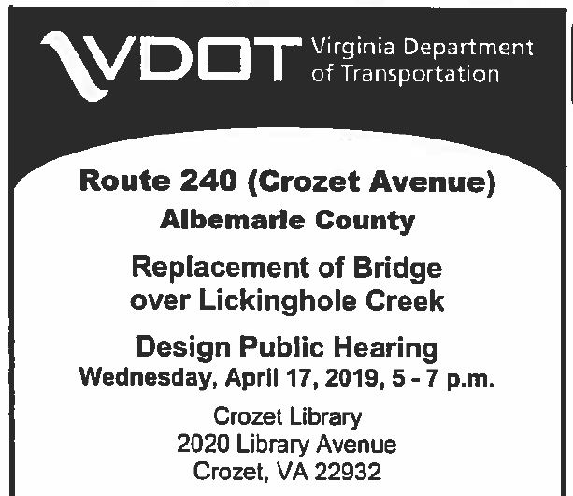
Crozet Community Advisory Committee
Notes:
Overview of todays presentation

Slide 5
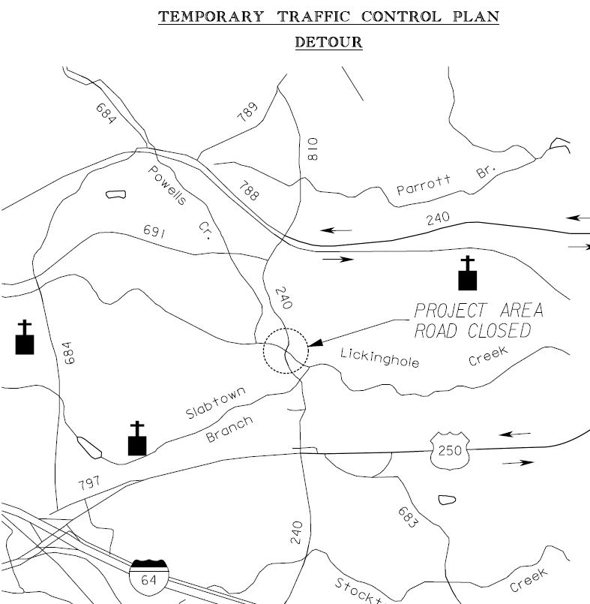
Crozet Community Advisory Committee
  Route 240 Bridge at Lickinghole Creek
  Cost: $1.9M
  Advertisement in 2022
Notes:
Overview of todays presentation

Slide 6
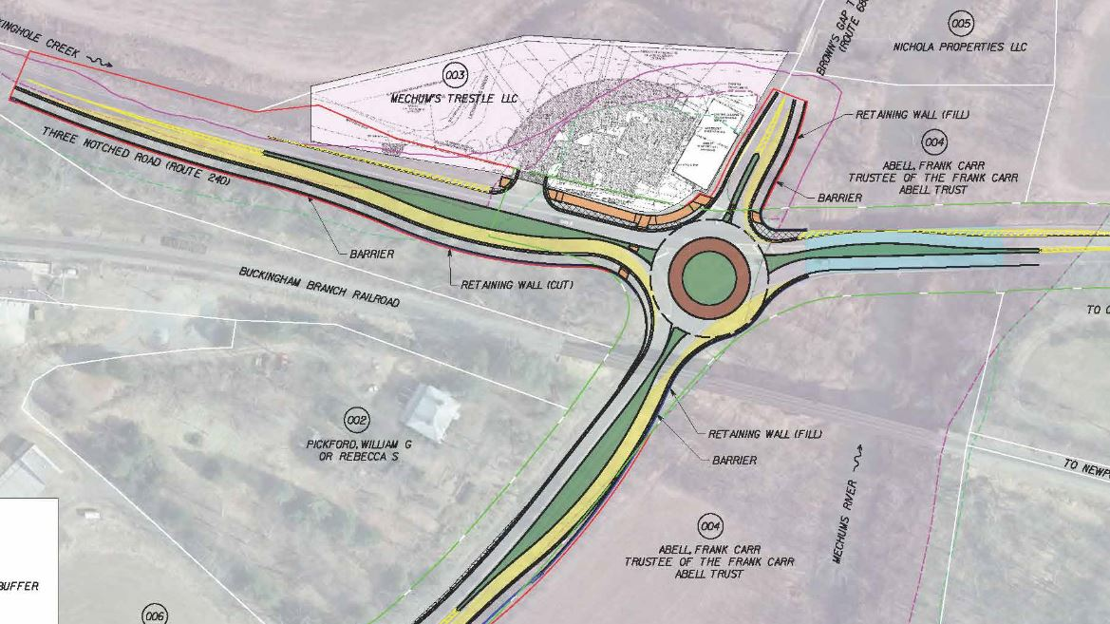
Route 240/ 250 Roundabout
Cost- $3.55M
Public Hearing – June 2019
Advertise – Nov 2020
Notes:
Overview of todays presentation

Slide 7
Route 250/ 151 Roundabout
Cost- $5.8M
Award Contract-June 2019
Construction Complete-Spring 2023
Notes:
Overview of todays presentation

Slide 8
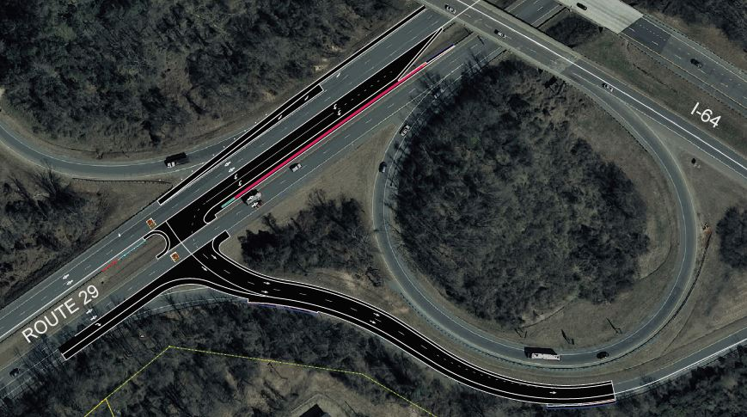
I-64 Exit 118
Cost- $1.0M
Award Contract-June 2019
Complete-Spring 2023
Notes:
Overview of todays presentation

Slide 9
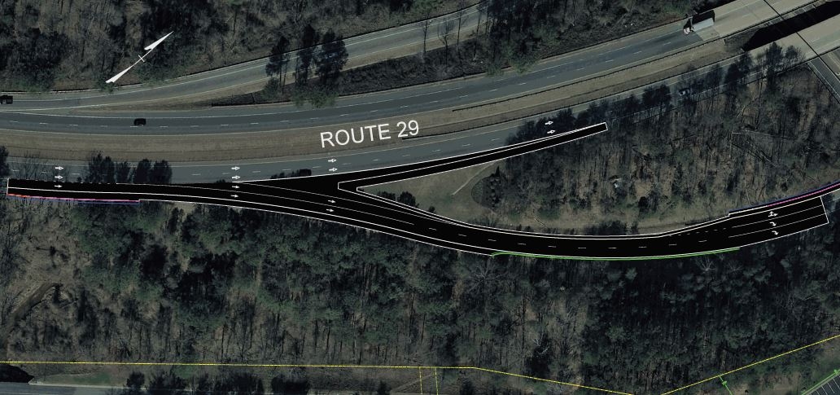
I-64 Exit 118 Fontaine
Cost- $2.9M
Award Contract-June 2019
Complete-Spring 2023
Notes:
Overview of todays presentation

Slide 10
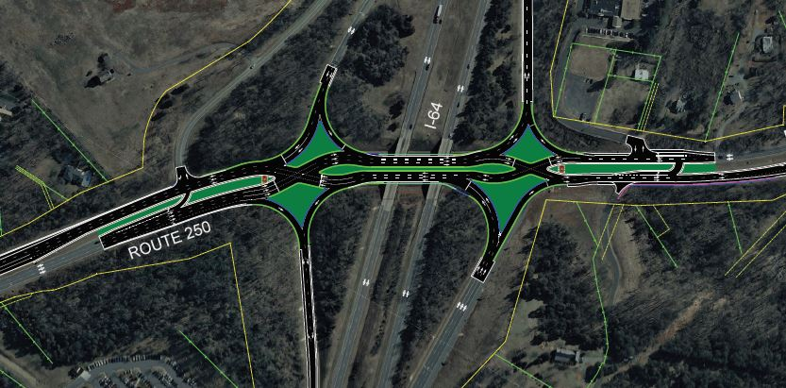
I-64 Exit 124 Diverging Diamond Interchange
Cost- $18.4M
Award Contract-June 2019
Complete-Spring 2023
Notes:
Overview of todays presentation

Slide 11
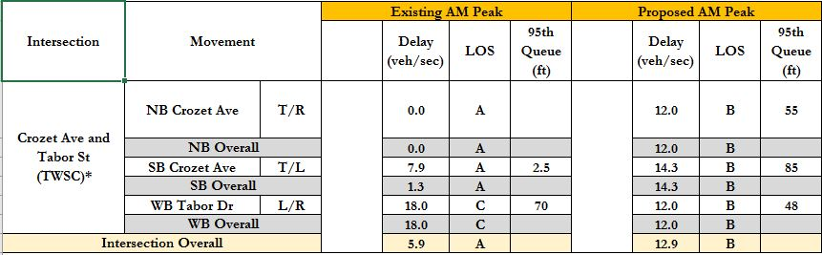
Crozet Ave and Tabor Street Morning
Notes:
Overview of todays presentation

Slide 12
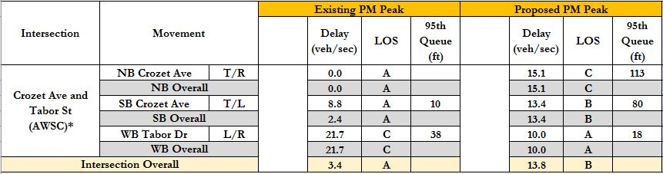
Crozet Ave and Tabor Street Afternoon
Notes:
Overview of todays presentation

Slide 13
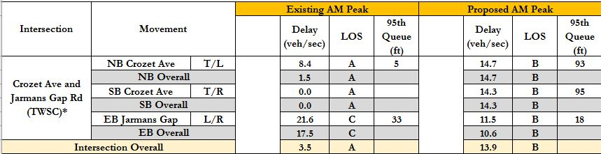
Crozet Ave and Jarmans Gap Road Morning
Notes:
Overview of todays presentation

Slide 14

Crozet Ave and Jarmans Gap Road Afternoon
Notes:
Overview of todays presentation

Slide 15
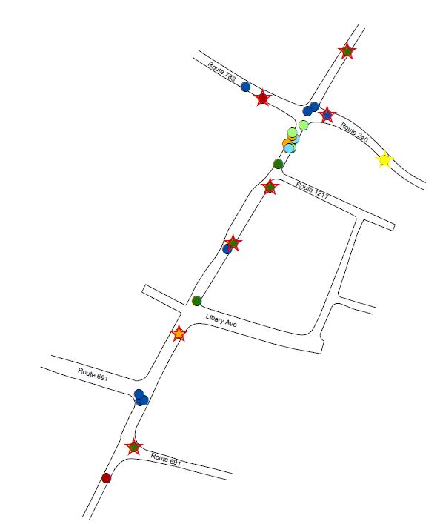
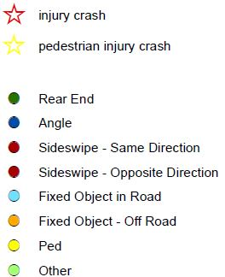
Crozet Ave Crashes
Notes:
Overview of todays presentation

Slide 16
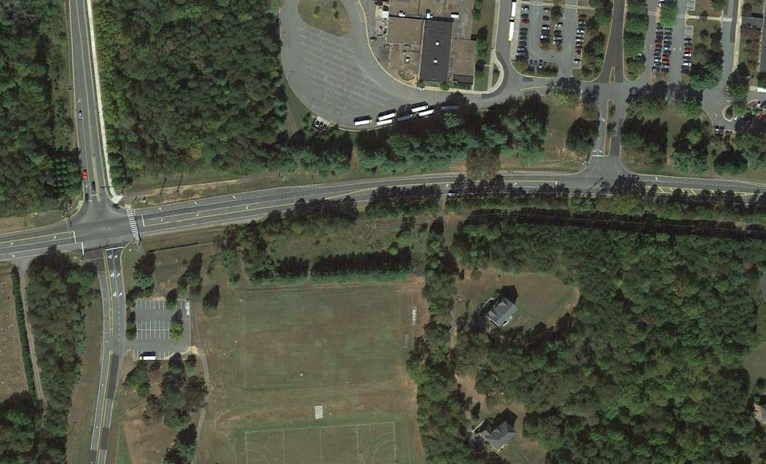
Route 250 Schools 2017 Traffic Plan
Notes:
Overview of todays presentation

Slide 17
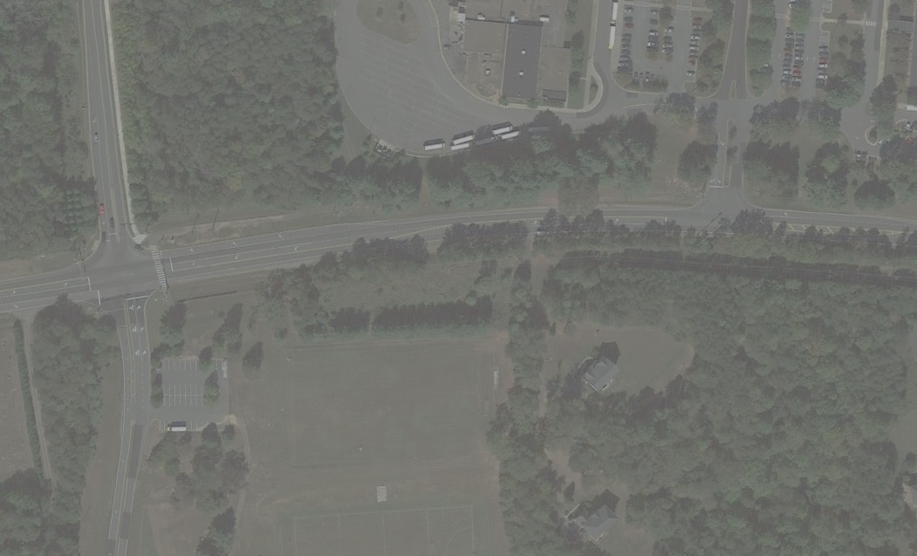
Route 250 Schools 2017 Traffic Plan
VDOT received a request to improve flow during school drop off and pickup
Consultant study recommended signal timings and circulation improvements.
The goal was to maximize the flow for all approaches and keep bus traffic on schedule
Notes:
Overview of todays presentation

Slide 18
Route 250 Schools 2017 Traffic Plan
Allow bus traffic to flow out or into schools in 2 cycle phases
Station a Sheriff Deputy at the WAHS intersection for safe pedestrian crossings
Modify Brownsville parent drop off circulation
Notes:
Overview of todays presentation

Slide 19
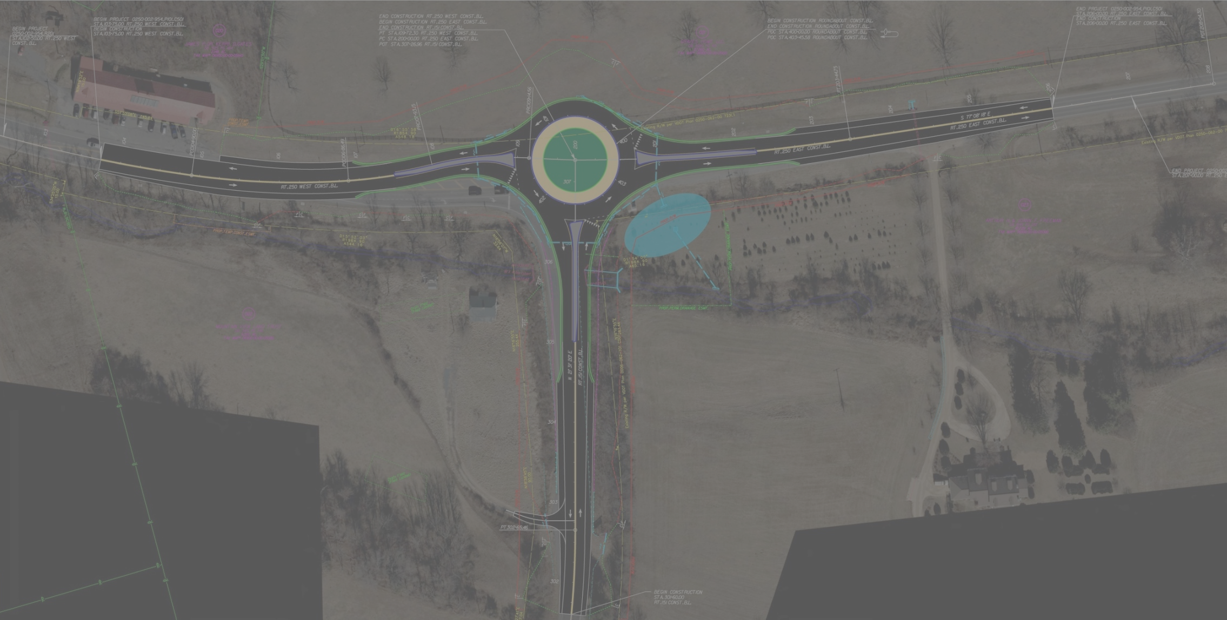
Crozet Community Advisory Committee
Thank You For Your Time Today.

